Slide 1

Managing People through Change
Pamela Yates
Business Consultant
Xacta Group

Slide 2
Agenda
Managing change
  A programme
  A manager
  An individual
Critical success factors
Successful change projects
Other areas ??

Slide 3
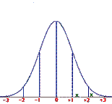



Managing Change
Driving Forces
Change Event
Restraining Forces
Today
The
New
World

Slide 4
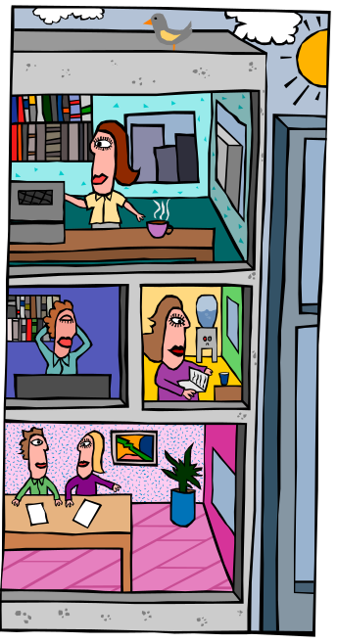
Managing a change programme
Drivers for Change
Strategy
Communications
Reward & Recognition
Training
Measurement & Reporting
Organisational realignment
Support
Anchoring the change

Slide 5

The Drivers for Change
Customer expectations
Technology
Competition
Legislation
Economy
Where are you now?
Where do you want to be?

Slide 6
Strategies for Change
Urgency / Pressure
Organisational climate
Culture
Management style
Participation
Consult Collaborate
Tell Sell
Time

Slide 7

Focus of Change
Technology
Performance Management
Skills Development
Organisational Realignment
New customers / products / services

Slide 8

Communications
Help people make the link between the strategic direction and the expected changes
Take time to communicate
  Assertion vs Involvement
Understand the audience
  What’s in it for me?
  Who will I listen to?
  What are the messages?
Communicate, listen, communicate, listen, communicate, listen

Slide 9

Training
Knowledge
  What do I need to know?
Skill
  What do I need to do?
Attitude
  How do I feel?
Analyse, Design, Develop, Test, Deliver
Link with performance competencies
Ongoing / induction training

Slide 10

Rewards & Recognition
Reward leaders / enthusiasts / early adopters
Acknowledge new behaviours
Recognise early wins
Motivate through the peaks and valleys of change
Develop “war stories” and success stories

Slide 11

Measurement & Reporting
Identify measures of success
Align business, team, and individual measurement systems
Focus management reporting
Review performance measures

Slide 12
Organisational Alignment
Does the organisational model support the change required?
  Identify organisational issues
  Review processes
    Process improvement vs reengineering
  Review information flows
  Review roles and responsibilities

Slide 13

Support
Before the change
  Identify and manage issues
During the change
  Hand-holding
After the change
  Help Desk in place

Slide 14

Anchoring the change
Key Measures
  Benefits / Results
  Usage / Participation
Management Reporting
  Senior Management participation
  Front-line exposure
Performance Management
  Competencies
  Job Descriptions
  Reward and recognition

Slide 15

Managing a team
Communicate
  Key messages
  Beware of mixed messages
  Each opportunity
Identify and eliminate obstacles
  Understand objections
  Understand performance expectations
  Don’t let comments slide
  Take action
Demonstrate your commitment
  Be visible and unwavering

Slide 16
Moving through change
Aware of the need to change
  Worry, uncertainty, doubt, cynicism
Participate in the change
  Enthusiast, supporter, blocker, ignorer
Knowledge of how to change
  Participator, influencer, skeptic
Able to implement the change
  Skilled, knowledgeable, supported
Transitioned to the new world
  Imbedded, transparent
“The way we do things round here”

Slide 17

Critical Success Factors
Need or urgency or vision
Executive support
Communication
Systematic planning
Short term wins
Long term anchors

Slide 18
Successful Change Projects
Internal focus to customer focus
  Strong executive support
  Vision and plans communicated
  Enthusiasm and management support
Employee responsibility & accountability
  Sense of urgency
  Committed sponsor
  Strong consultative environment
Business unit closure
  Sense of urgency
  Detailed planning
  Co-ordinated team

Slide 19


Conclusion
It is never easy!!
Two steps forward, one step back
Keep the big picture in mind
Persistence / Focus / Stamina

Slide 20
Finally………
Any Questions

